Slide 1

Book Recommendation System
CMPE 266

Slide 2




Vineet Khatwal
Aayushi Gupta
Rohit Sapkal
Maulin Bodiwala
Maulin Bodiwala
ID: 013733590
No: +1-669-212-1648
Vineet Khatwal
ID: 013855764
No : +1-669-212-1095
Rohit Sapkal
ID: 013818623
No : +1 (408) 882-7756
Aayushi Gupta
ID: 013799578
No : +1-650-305-9520
Team members

Slide 3

Recommendation System- what are they?
Recommender systems are everywhere from Amazon, Netflix to Facebook.
They have allowed businesses to save shelf space and provide online customers with recommendations based on their preferences, which are reflected by their past behavior.
They help businesses capture the long tail of the market.

Slide 4

Book Recommendation System - how it works?
IN ORDER TO SUGGEST BOOKS TO CUSTOMERS, WE WANT TO BUILD A COMPREHENSIVE RECOMMENDATION SYSTEM BASED ON USER RATINGS.
WE ARE USING A COMBINATION OF ITEM BASED AND USER BASED COLLABORATIVE FILTERING TECHNIQUES ( A HYBRID APPROACH) TO SUGGEST BOOKS.
MOTIVATION: EVEN THOUGH A NUMBER OF BOOKS ARE AVAILABLE, WE BELIEVE MANY OF THE BOOKS ARE NOT SELECTED BECAUSE THEY ARE NOT THAT FAMOUS AND IF SUCH BOOKS ARE SUGGESTED TO THE CUSTOMERS, THEY MAY CHOOSE TO READ THEM AND MAY EVEN LIKE THEM!

Slide 5
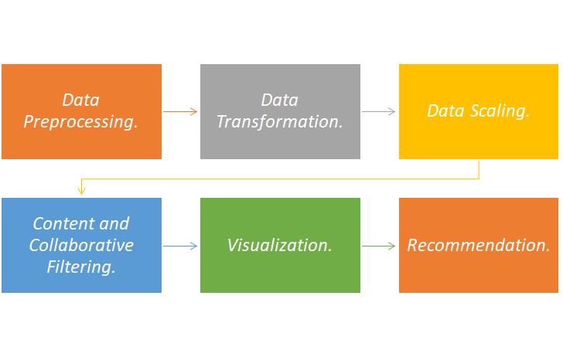
Approach
Approach

Slide 6
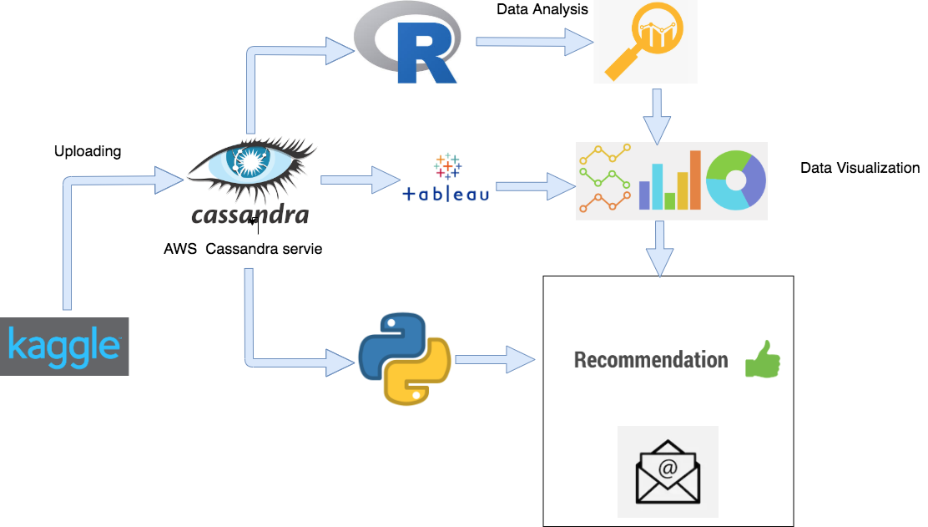
Project Architecture Diagram

Slide 7
Implementing Service Oriented Architecture
Identifications: | Specifications: | Realizations
Data Cleaning Service Data Analysis and Visualization Service with dynamic filtering Data Querying Service Data Recommendation Service In Person Mailing Service | Using our Data Cleaning Service one can Preprocess the Data Using our Data Analysis Service one can Analyze the Data with Interactive graphs and dynamic filters Using our Data Quering service user can search for the books from the Cassandra Database Our recommendation service will give relevant recommendations to the User In Person mailing Service will Send mails on person email id with updates and relevant book recommendations | Dataset from Kaggle : S3 bucket to store the files Data Preprocessing with R - Mean-mode imputation,Handling missing Data, Cassandra to store and retrieve the Data Drawing insights and Data Visualization - Tableau Best Recommendation and in person Email Based on collaborative filtering – Python

Slide 8

Services Used
Data Preprocessing.
Data Visualization in R.
Clustering and Euclidean Distance Calculation.
Recommendation.
=> For content based filtering
=> Collaborative filtering
Emailing the recommendations.

Slide 9
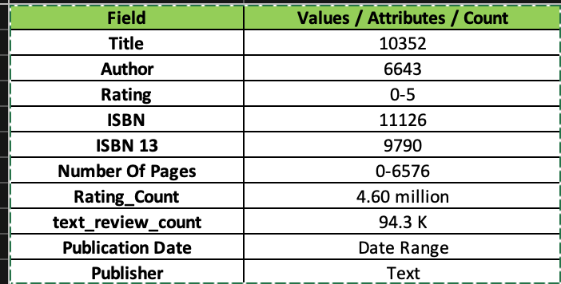
DataSet
In building our recommendation system, we have used Kaggle book reviews dataset from 1995 to 2015. This consists of 10000 records
Below is a link to the dataset:
https://www.kaggle.com/jealousleopard/goodreadsbooks#books.csv
Below are the features available in the dataset:

Slide 10
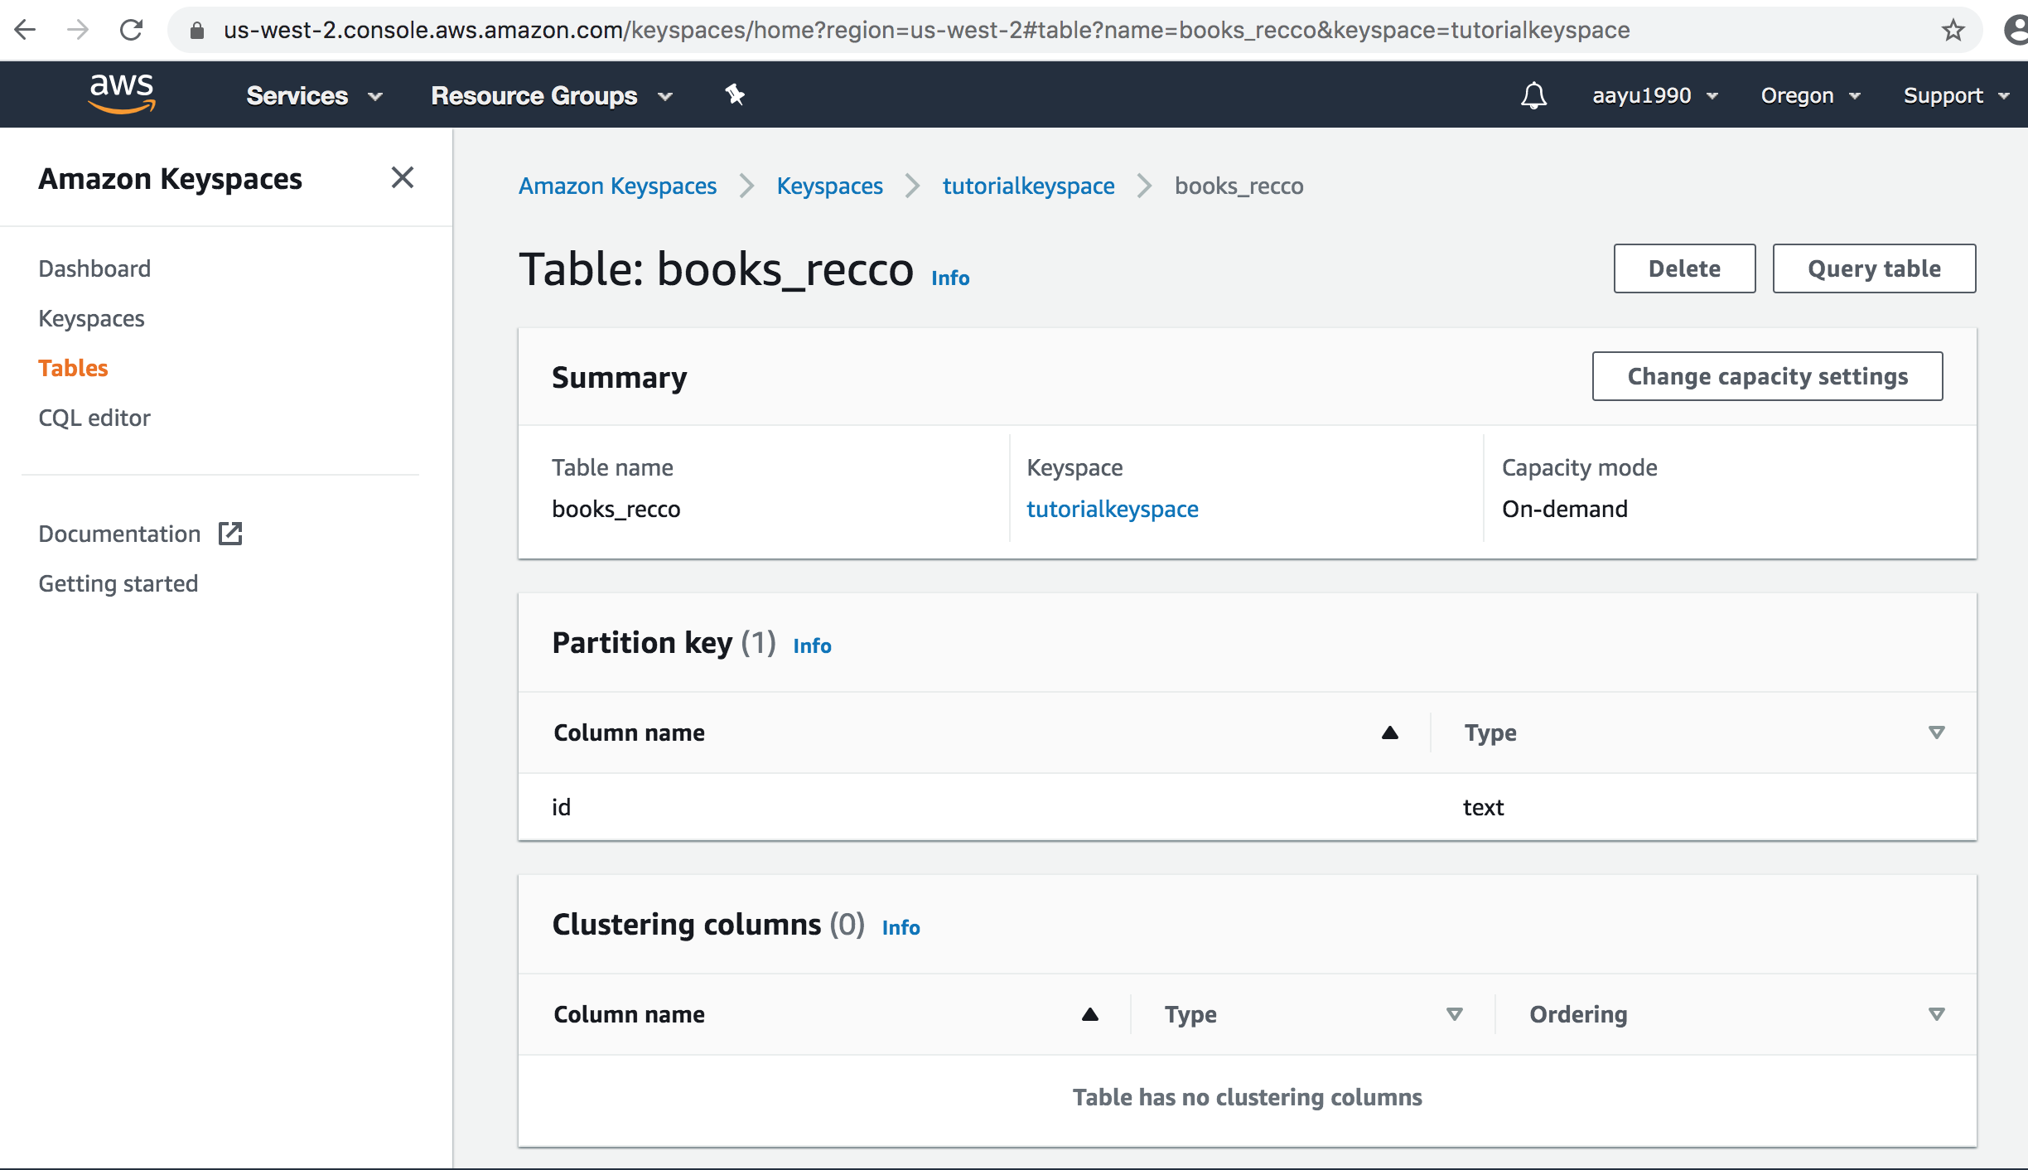
Cassandra database setup on AWS & Data import
Created AWS cassandra keyspace service and connected to it using AWS IAM authentication using terminal.

Slide 11
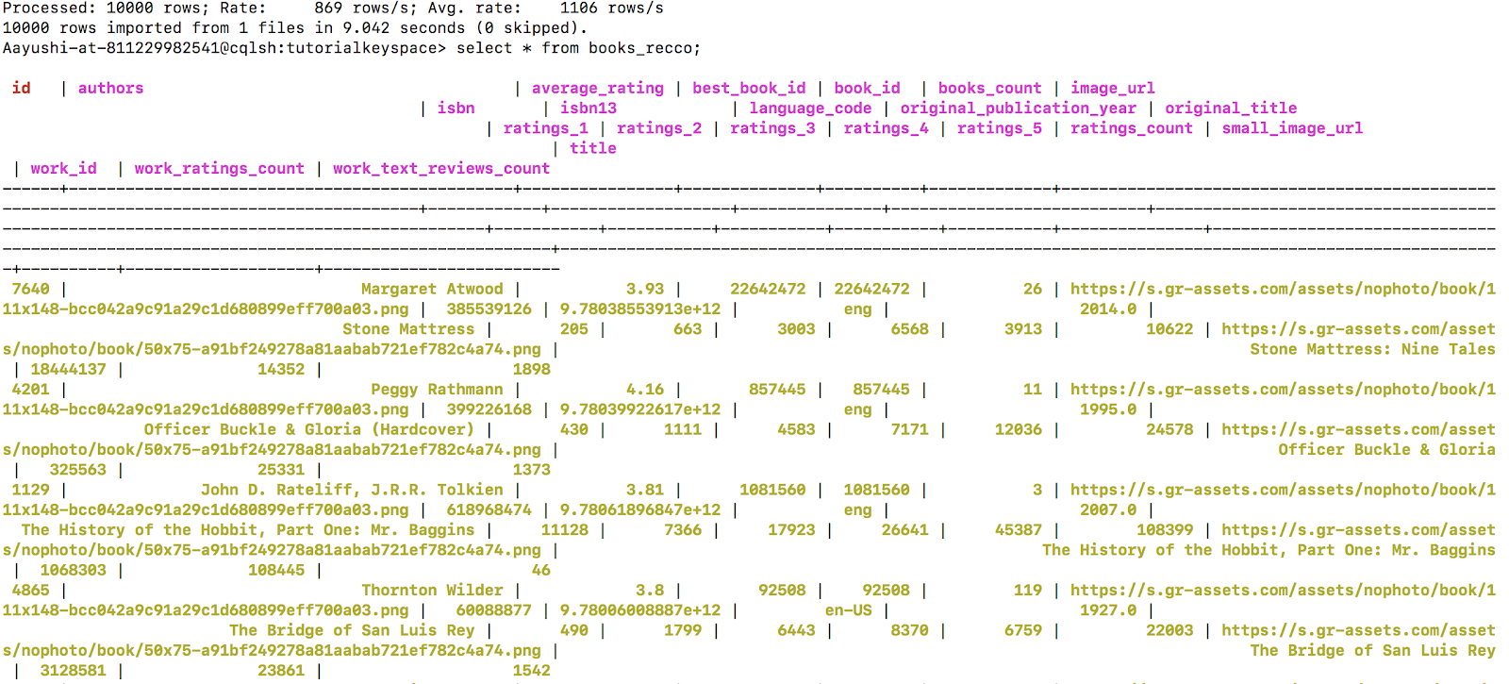
Cassandra Database Setup & Data Import
Setup Cassandra database with a Key space called ‘tutorials point’ and replication factor of 3 using the AWS service Key Space for Cassandra.
Loaded 11123 rows of data into the database.

Slide 12
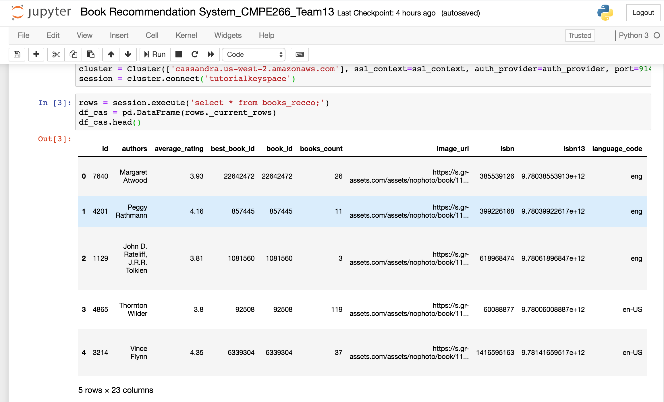
Connecting to AWS Database from Python Code

Slide 13

Data Cleaning & Preprocessing
We will analyze all the fields and inspect which fields are not required for recommendation to reduce expensive calculation overhead (Dimensionality Reduction). We will also focus on the following aspects while data cleaning and normalization:
Handling Missing Values.
Fixing issues with unexpected separators like ‘ “ ‘ , “ ‘ “, “ , ” , “//”, “/t”
Checking duplicate records and dropping them.
Checking outliers and removing them.
Adjusting user biases.

Slide 14
Data Visualization Libraries used:
Lattice #Visualisation
Highcharter #Visualisation
RColorBrewer #Visualisation
Plotly #Visualisation
RGL #Visualisation
ggplot2 #Visualisation
dplyr #Dataframe operations
caret #Models
rpart #Decision Tree
janitor #Validating colnames of dataframe
partykit #Visualizing Decision Tree

Slide 15
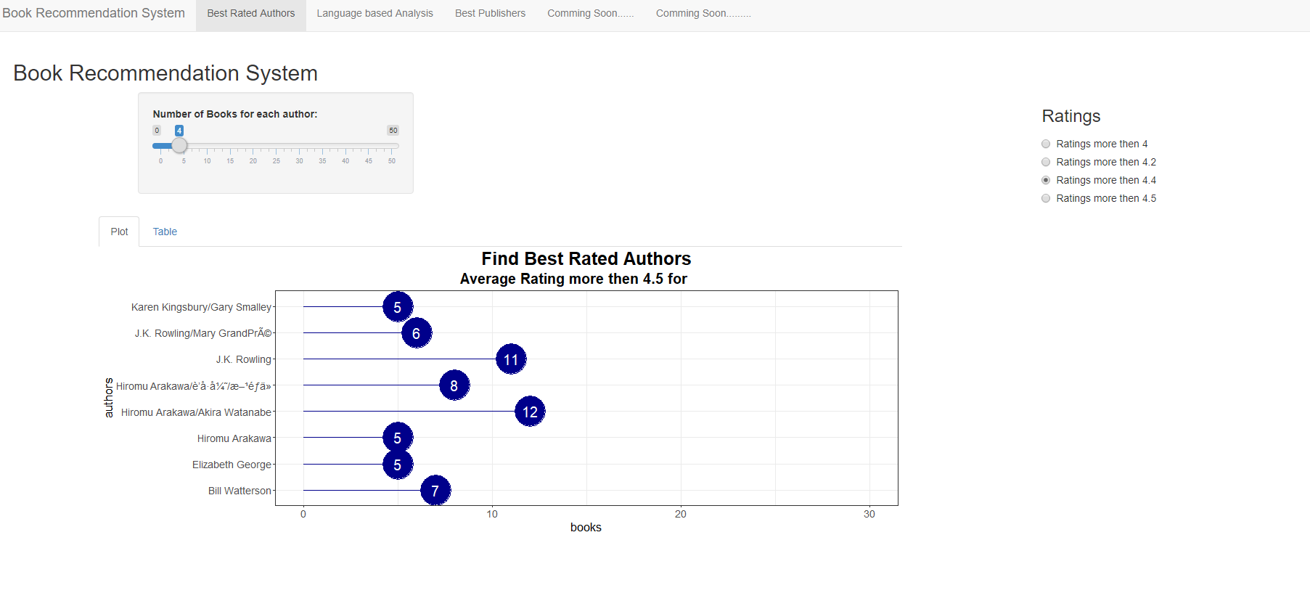
Best Rated Authors

Slide 16
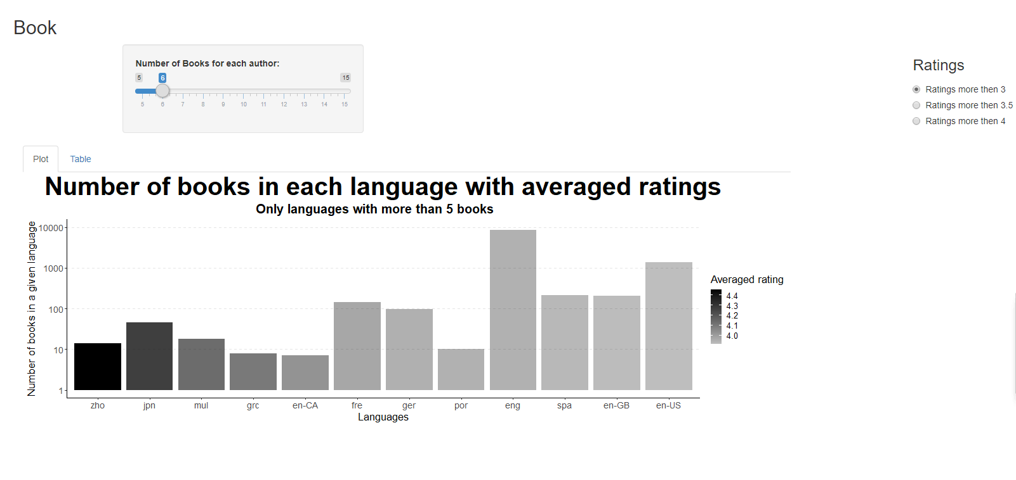
Popular books in Listed Languages

Slide 17
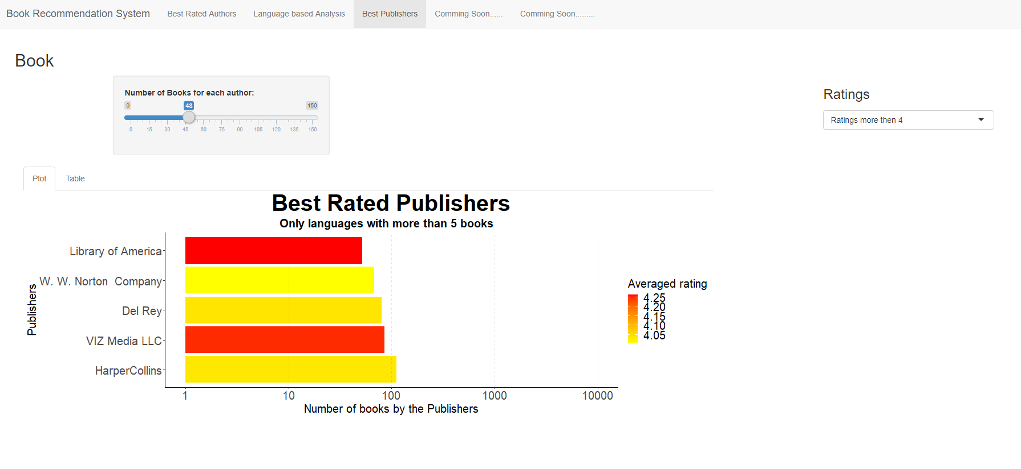
Highly Acknowledged Publishers with >4 ratings

Slide 18
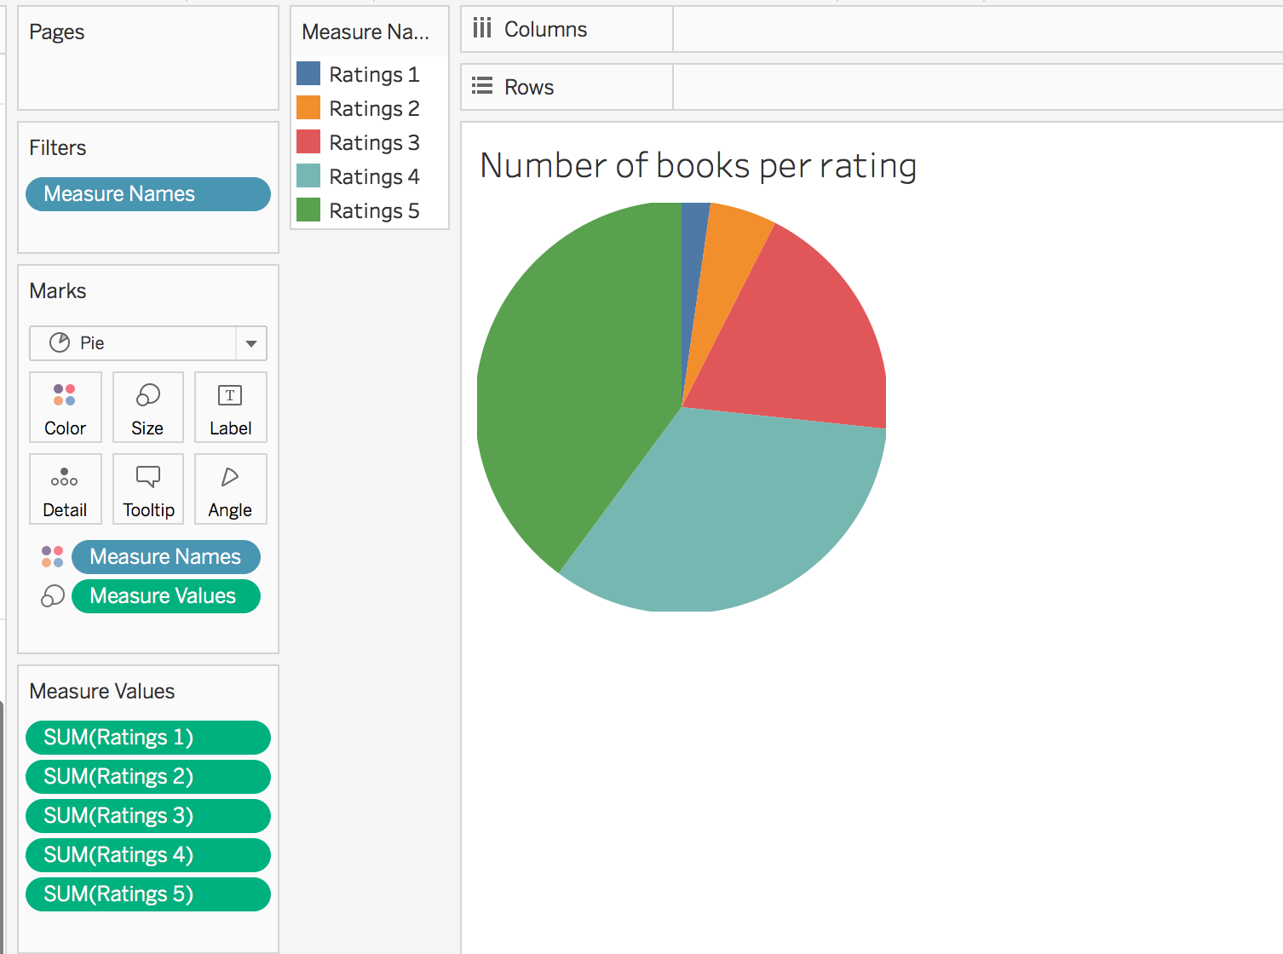
Number of books per rating:

Slide 19
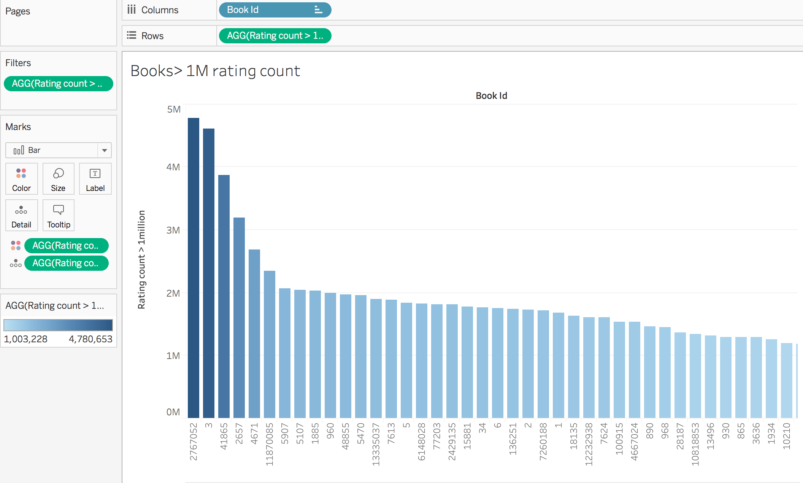
Books with more than 1M ratings:

Slide 20
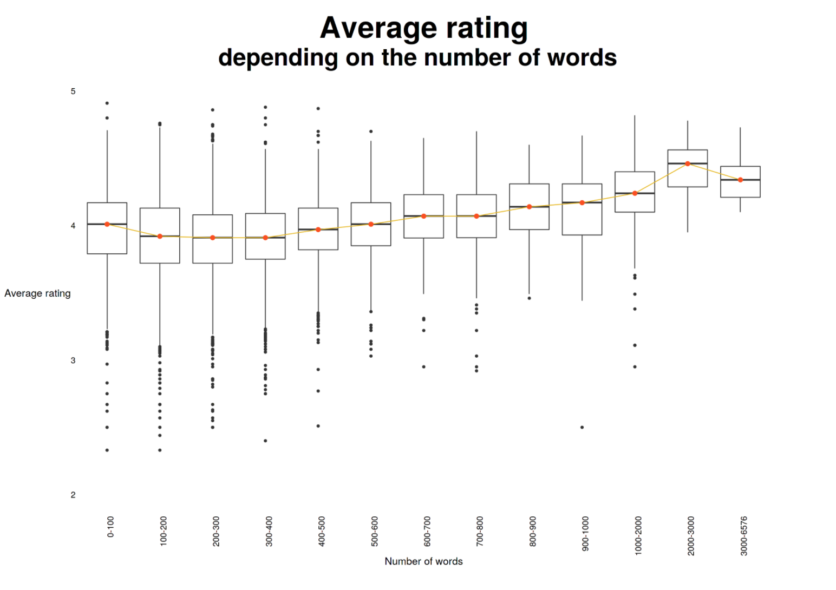
Average Rating on the basis of book size:

Slide 21
Recommendation Approach
Content-based :
Content Filtering :
Needs information of own characteristics, rather than using users’ interactions and feedbacks.
No Cold Start Problem.
Useful for users with unique choice.
Less Accurate
Collaborative Filtering :
Needs historical preference on a set of items.
More Accurate.
User Based and Item Based.
Useful for sparse Data

Slide 22

Hybrid Approach - KNN
Pros
● Very easy and simple to implement.
● KKN does not require any training prior, so the updates are easy
● KNN is relatively faster than other algorithms like SVM, linear regression, etc.
● Since, no prior training is required, new data can be added easily. This makes the solution scalable.
Cons
● As the number of dimensions increases, Euclidean distance calculation becomes difficult.
● KNN algorithm doesn't operate well with categorical features.

Slide 23
Python Libraries Used
Numpy
pandas
seaborn
newspaper
Matplotlib
progressbar
Sklearn (KMeans and neighbors)
MIMEText
MIMEMultipart
smtplib

Slide 24
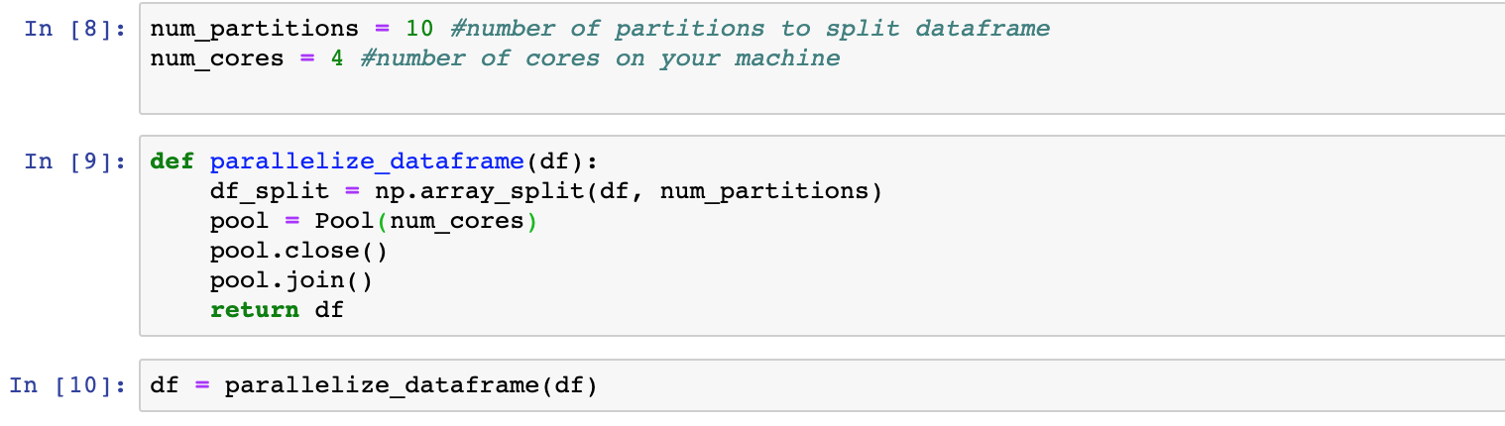
Using PySpark for data parallelization
Data Parallelization

Slide 25
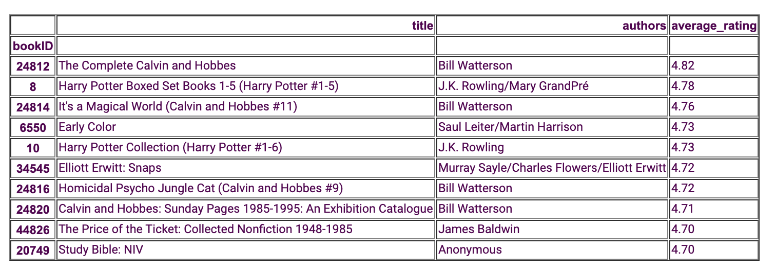
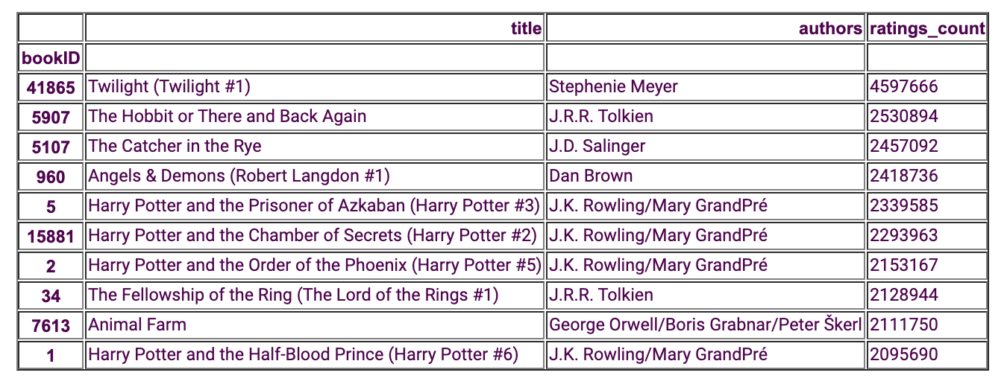
Resolving Cold Start Problem-
Top best rated books.
Content Based Filtering
Maximum rated books.

Slide 26
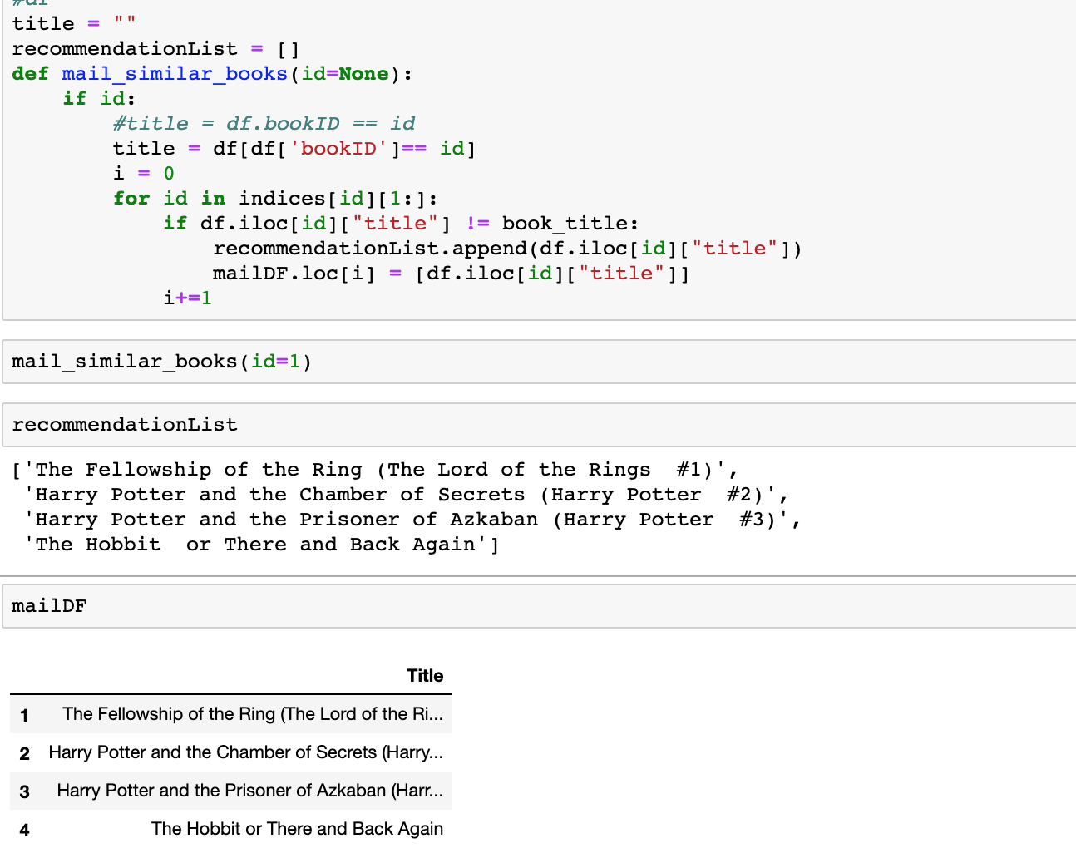
Collaborative Filtering for recommendation

Slide 27
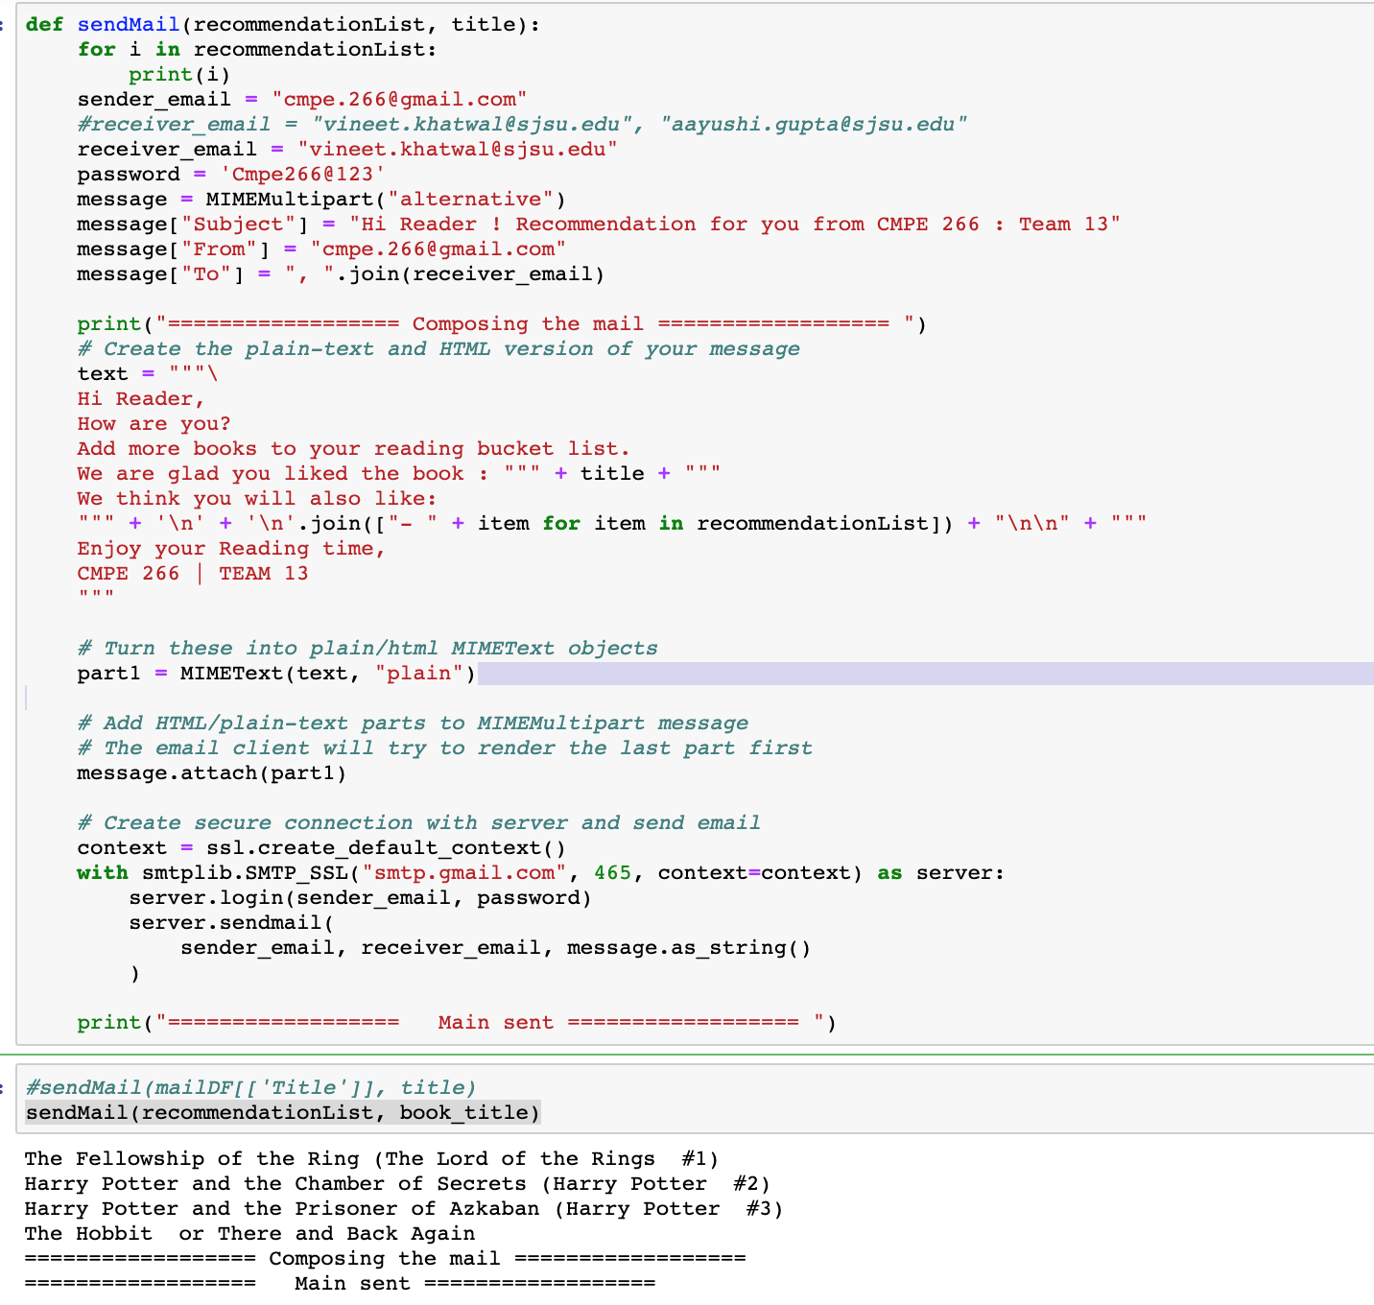
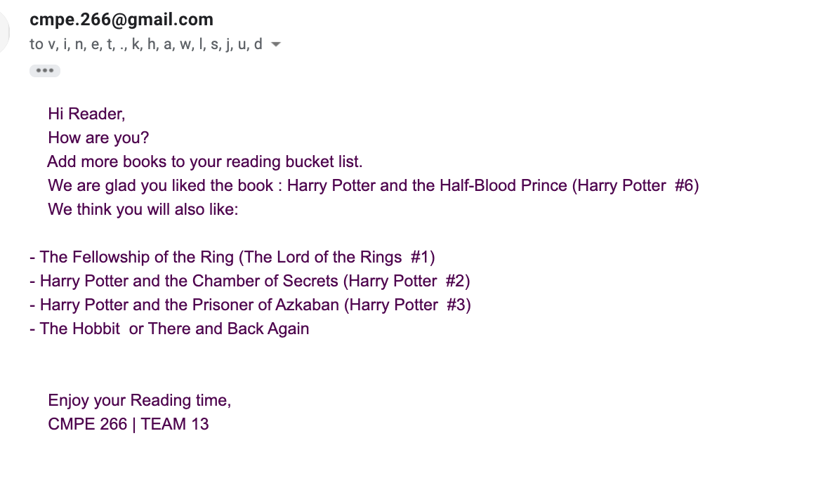
Recommendation Mail

Slide 28
Conclusion
Implementing SOMA architecture in a real time project
R programming is very efficient data analysis tool
Tableau is very helpful for quick data visualisations and analysis
We can handle big datasets by using AWS Cassandra setup
Python is great for building machine learning recommendation model

Slide 29



Slide 30


